Slide 1


GitHub Actions IL DEVOPS 4/18/24

Slide 2

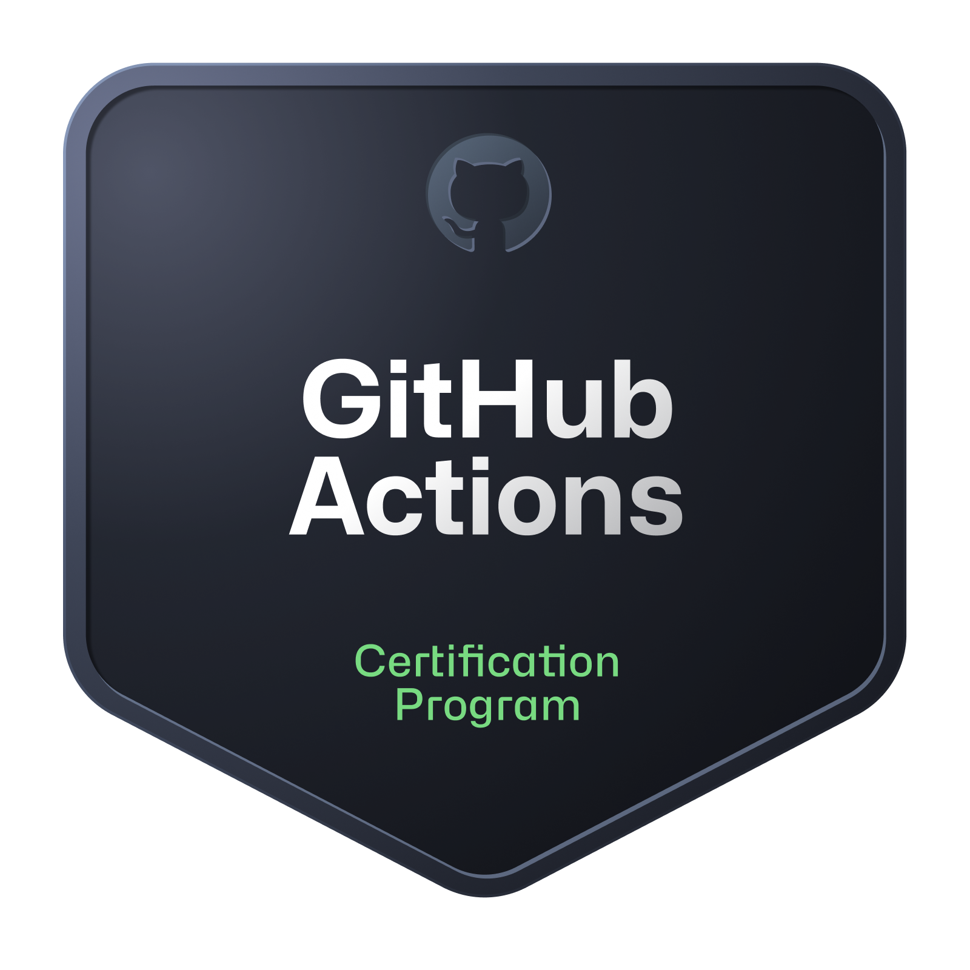
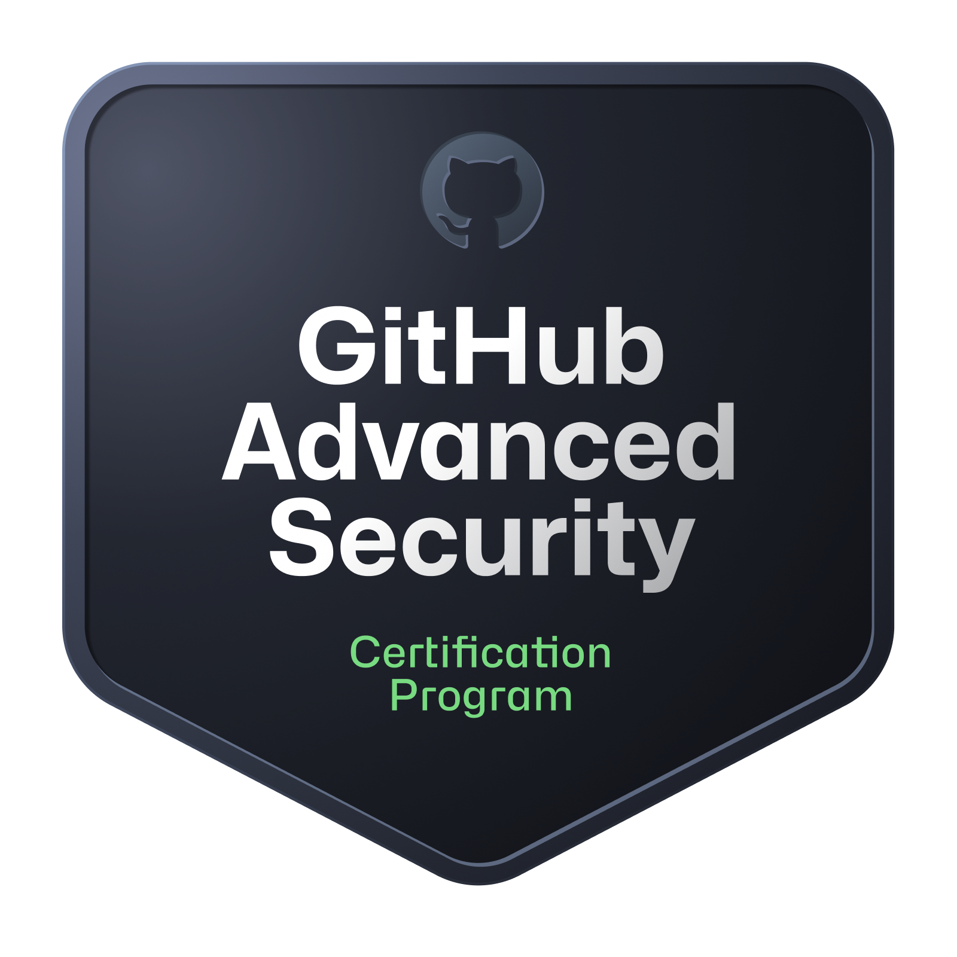
Nathan Nellans - NathanNellans.com - linkedin.com/in/nnellans

Slide 3
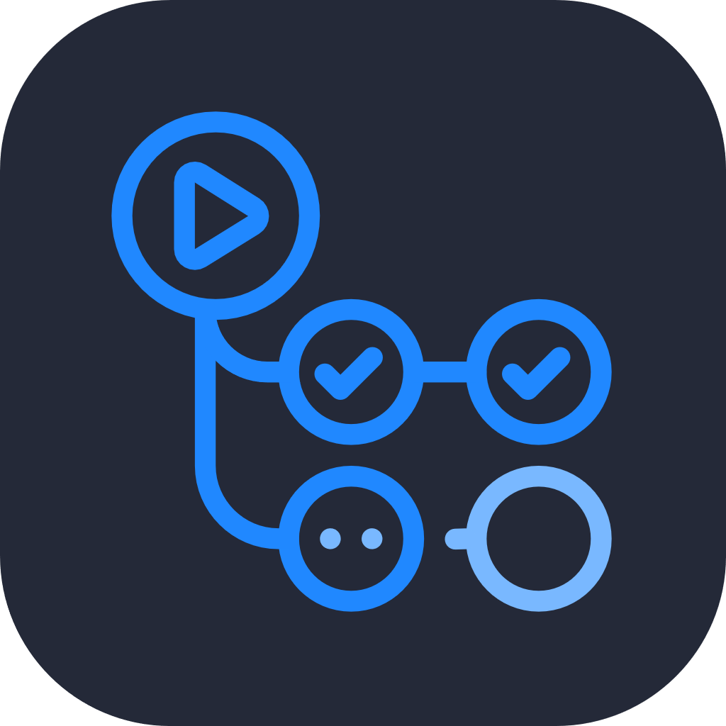
GitHub Actions
“GitHub Actions is a Continuous Integration and Continuous Delivery (CI/CD) platform that allows you to automate your build, test, and deployment pipeline.”
GitHub Actions are tightly integrated with the GitHub platform
Must have a GitHub Account & GitHub Repo
GitHub Workflows are defined purely as code, as YAML files stored in your Repo:
<repo>\ .github\ workflows\ some-workflow.yaml another-workflow.yaml

Slide 4
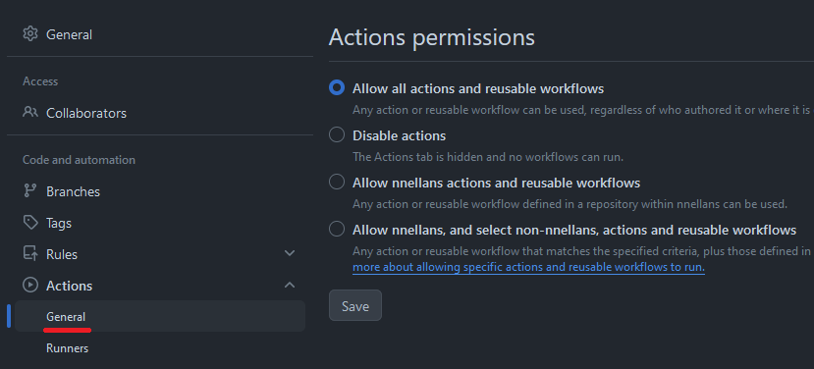
Enable / Disable
More options when using a GitHub Organization or Enterprise

Slide 5
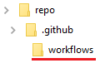
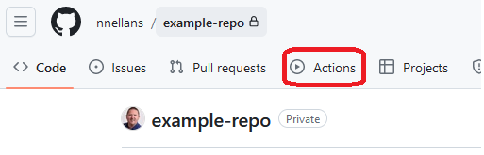

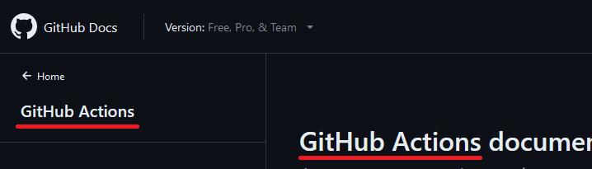

Terminology
GitHub Workflows vs. GitHub Actions
Workflow
Action
Action
Action

Slide 6
Workflow Basics
Workflow
Trigger
Trigger
1. Trigger
One or more Triggers per Workflow
Manual, Automatic, Schedule, External Webhook
2. Jobs
One or more Jobs per Workflow
3. Steps
One or more Steps per Job
Job 1
Job 2
Job n
Step 1
Step 1
Step 1
Step 2
Step 2
Step 2
Step n
Step n
Step n

Slide 7
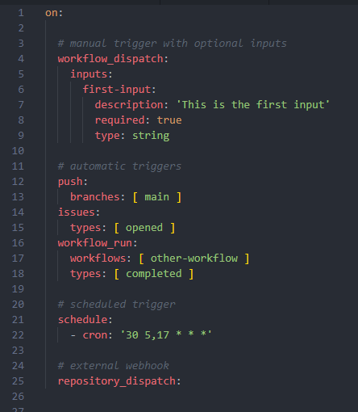
1. Trigger (aka “ON”)
Manual Triggers (aka “workflow_dispatch”)
Supports optional inputs (text, checkbox, drop-down)
Automatic Triggers
Almost any activity in GitHub
New Pull Request, new Issue, new Discussion, etc.
After another Workflow completes (aka “workflow_run”)
Schedule
Specified in CRON format
External Webhook (aka “repository_dispatch”)
A special, authenticated POST request sent to: https://api.github.com/repos/<owner>/<repo>/dispatches

Slide 8

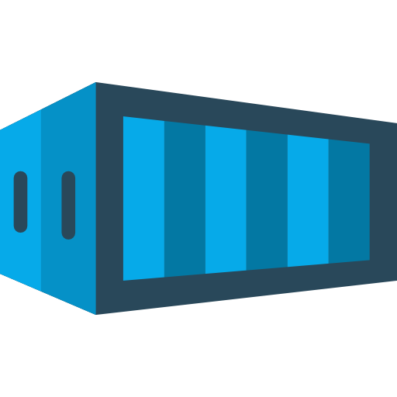
2. JOBS
Workflow
Trigger
Trigger
A collection of 1 or more Steps
GitHub Runner:
Each Job runs on its own unit of compute (aka “runs-on”)
Each Runner only runs 1 Job at a time
All Jobs in your Workflow run in parallel, by default
Dependencies can be used for a custom order of operations
Job 1
Job 2
Job n
Step 1
Step 1
Step 1
Step 2
Step 2
Step 2
Step n
Step n
Step n
Runner1
Runner2
Runner3

Slide 9
RunnerS: Github-hosted
Supports Linux (Ubuntu only), Windows (Server only), MacOS (both Intel & M1)
Fixed hardware choices (CPU, RAM, Disk)
Standard sizes & Larger sizes
Access to public resources only
OS images maintained by Microsoft, updated weekly
Includes many tools & programs pre-installed
Ephemeral
Cost
Public repos: Free
Private repos: Monthly allotment of free minutes, after that a per-minute cost
“Larger” sizes always charged at per-minute rate

Slide 10
Runners: Self-hosted
Better OS support
More flavors of Linux (RHEL, Fedora, etc.)
Windows client support (7, 8, 10)
Privately hosted by you
Physical machines, VMs, Containers, Kubernetes (ARC)
Full control of specs (CPU, RAM, Disk)
Requires maintenance (patches, updates, fixes, etc.)
You must install the GitHub Runner agent and connect/authenticate to your GitHub account
Cost: Free

Slide 11
3. Steps
Workflow
Trigger
Trigger
Steps can do 1 of 3 things:
Run a command (aka “run”)
Run a GitHub Action (aka “uses”)
Run a Docker Container (aka “uses: docker”)
The Runner executes the Steps one-by-one in order
Steps in the same Job share the filesystem on the Runner
Each Step runs in its own process on the Runner
Job 1
Job 2
Job n
run
run
run
action
action
action
docker
docker
docker
Runner
Runner
Runner

Slide 12
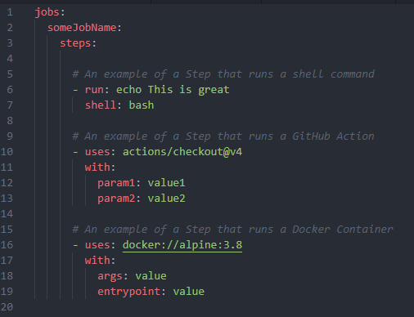
3. Steps
Runner
Runner
Runner

Slide 13
GitHub Actions
action.yaml
Actions are designed to make your life easier and reduce the amount of repetitive code in your workflows
They are meant to hold complex code that you can run repeatedly
Some examples: checkout a repo from GitHub, setup your build environment’s toolchain (setup Java, setup Gradle), or authenticate to your cloud provider
Public Actions are stored in public repos
“uses: azure/login@v2”
“github.com/azure/login” with Git Tag of “v2”
Can be published on GitHub Marketplace, but not a requirement
action.yaml
Runner
action.yaml

Slide 14


GitHub Actions
Workflow
Other Repo
Job 1
action
action.yaml
File must be named action.yaml
Actions in other repositories
uses: {owner}/{repo}@{ref}
Actions in folders in other repositories
uses: {owner}/{repo}/{folder}@{ref}
Actions can also be in the local repo
uses: ./.github/actions/{folder}
action
Other Repo
action
Folder1
action.yaml
Local Repo
Folder2
.github/actions/folder3
action.yaml
action.yaml

Slide 15
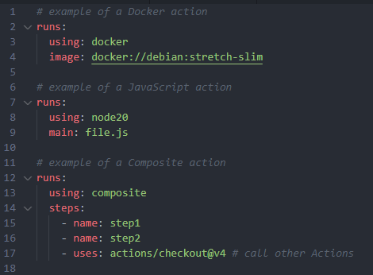
3 Types of Github Actions
action.yaml
Docker Actions (aka “runs.using: docker”)
Runs a Docker Container from a registry
Or, builds a Dockerfile on the fly and runs that image
Support pre and post scripts
JavaScript Actions (aka “runs.using: node”)
Executes a JavaScript file
Must be an all-in-one js file, including dependencies
Supports pre and post scripts
Composite Actions (aka “runs.using: composite”)
A collection of Steps
Can even call other Actions
Has no concept of Jobs
action.yaml
Runner
action.yaml

Slide 16
Example Actions
action.yaml
Official actions
Setup Java: actions/setup-java
Setup Python: actions/setup-python
Upload a Workflow artifact: actions/upload-artifact
Clean CODEOWNERS files: github/cleanowners
Configure GitHub Dependabot: github/evergreen
Login to Azure: azure/login
Run an Azure CLI command: azure/cli
Build and push a Docker image: docker/build-push-action
Setup Terraform: hashicorp/setup-terraform
Setup Gradle: gradle/actions/setup-gradle
Send a message on Slack: slackapi/slack-github-action
action.yaml
action.yaml

Slide 17
GitHub Secrets
action.yaml
When you need to use sensitive values in your Workflow files
Create via the GitHub UI
A single Secret can be used by multiple Workflows
Each repo has a limit of 100 Secrets
Once a Secret’s value is set, then you can no longer view it, you can only reset it to a new value
Workflow syntax: ${{ secrets.NameOfSecret }}
GitHub masks this value in any workflow logs
action.yaml
action.yaml

Slide 18
Reusable WOrkflows
Other Repo
.github/
workflows
action.yaml
More confusing terminology
A collection of reusable Jobs
Workflow files can be named anything.yaml
Workflow files must live in .github/workflows
Reusable Workflows in other repositories
uses: {owner}/{repo}/.github/workflows/{file}@{ref}
Reusable Workflows in the local repo
uses: ./.github/workflows/{file}
Workflow
file1.yaml
(10 Jobs)
Placeholder Job
Local Repo
Placeholder Job
.github/
workflows
action.yaml
file2.yaml
(3 Jobs)

Slide 19
PUTTING IT ALL TOGETHER
Workflow
Trigger
Job 1
You must create a Workflow file in your repo (a yaml file under .github/workflows)
Your Workflow must have 1 or more Triggers
Your Workflow must have 1 or more Jobs
A Job can run 1 or more Steps on a Runner
Steps can run commands, run Docker containers, or run GitHub Actions
GitHub Actions can run Docker containers, execute a JavaScript file, or run more Steps
A Job can also point to a Reusable Workflow
Reusable Workflows can contain multiple Jobs
Action
run
Docker
action
Node
Composite
docker
Runner
Reusable
Workflow
Job 2
Job
Job

Slide 20

Thank you
Nathan Nellans
Email: me@nathannellans.com
Web: www.nathannellans.com

